Slide 1
Sliding Window Protocol
Flow Control Technique in Computer Networks

Slide 2
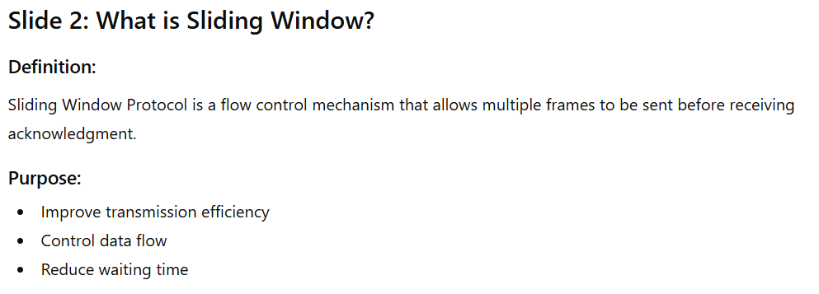

Slide 3
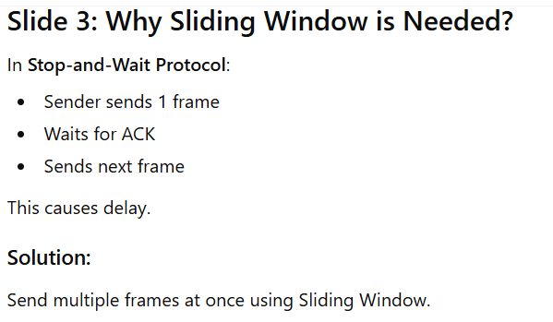
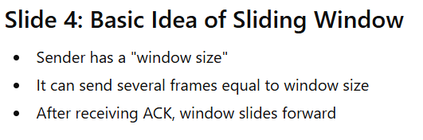

Slide 4
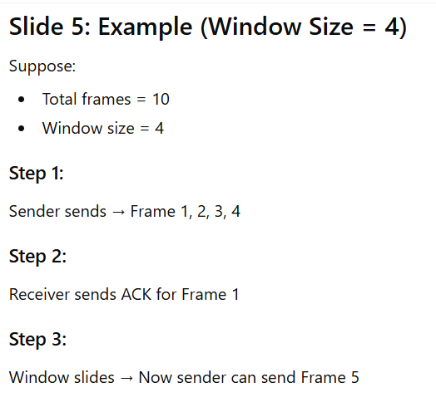
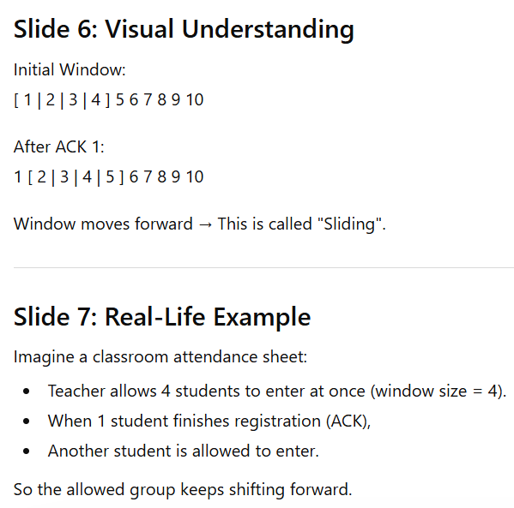

Slide 5
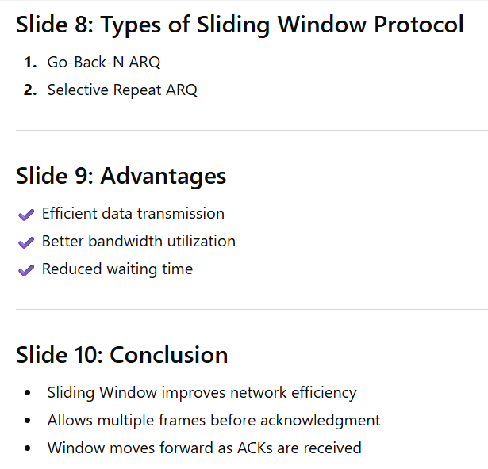

Slide 6
Main Comparison Table
Feature | Stop-and-Wait | Sliding Window
Frames Sent | One at a time | Multiple at a time
Efficiency | Low | High
Speed | Slow | Faster
Bandwidth Use | Poor | Efficient
Complexity | Simple | More complex
Buffer Requirement | Small | Larger

